Slide 1

The Balena IoT Ecosystem

Slide 2
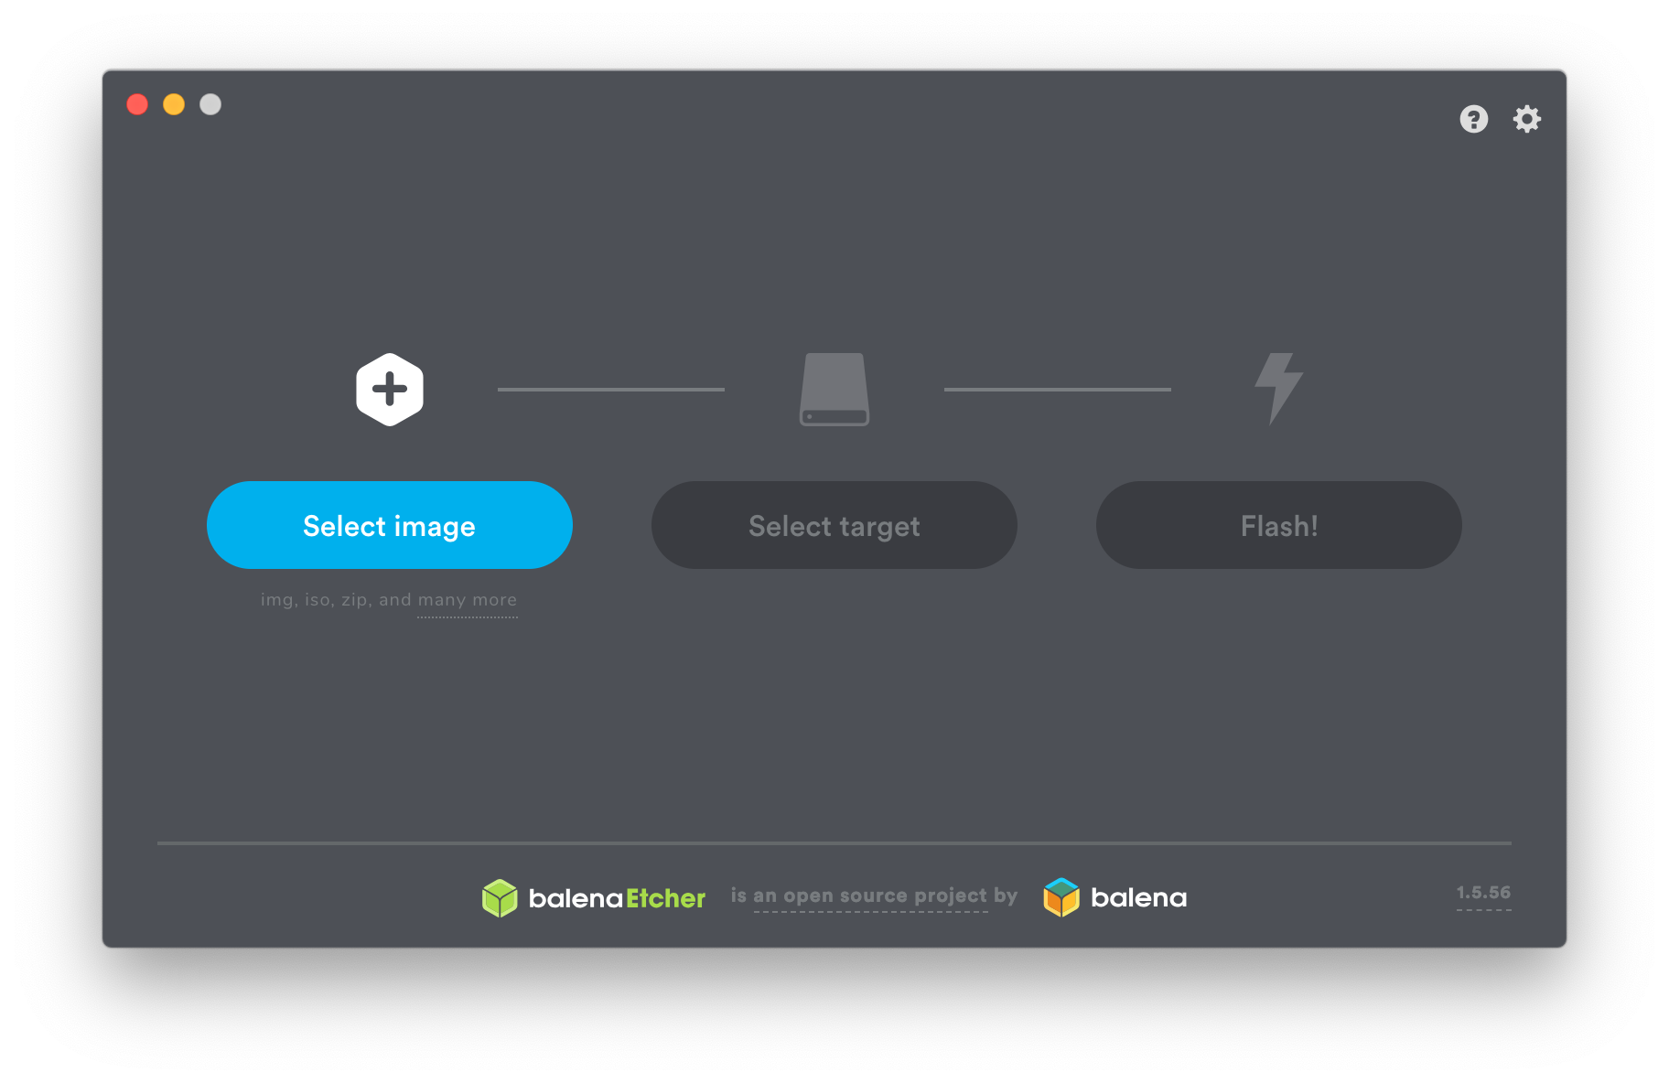
Notes:
I suspect there are some Etcher users in the audience.

Slide 3
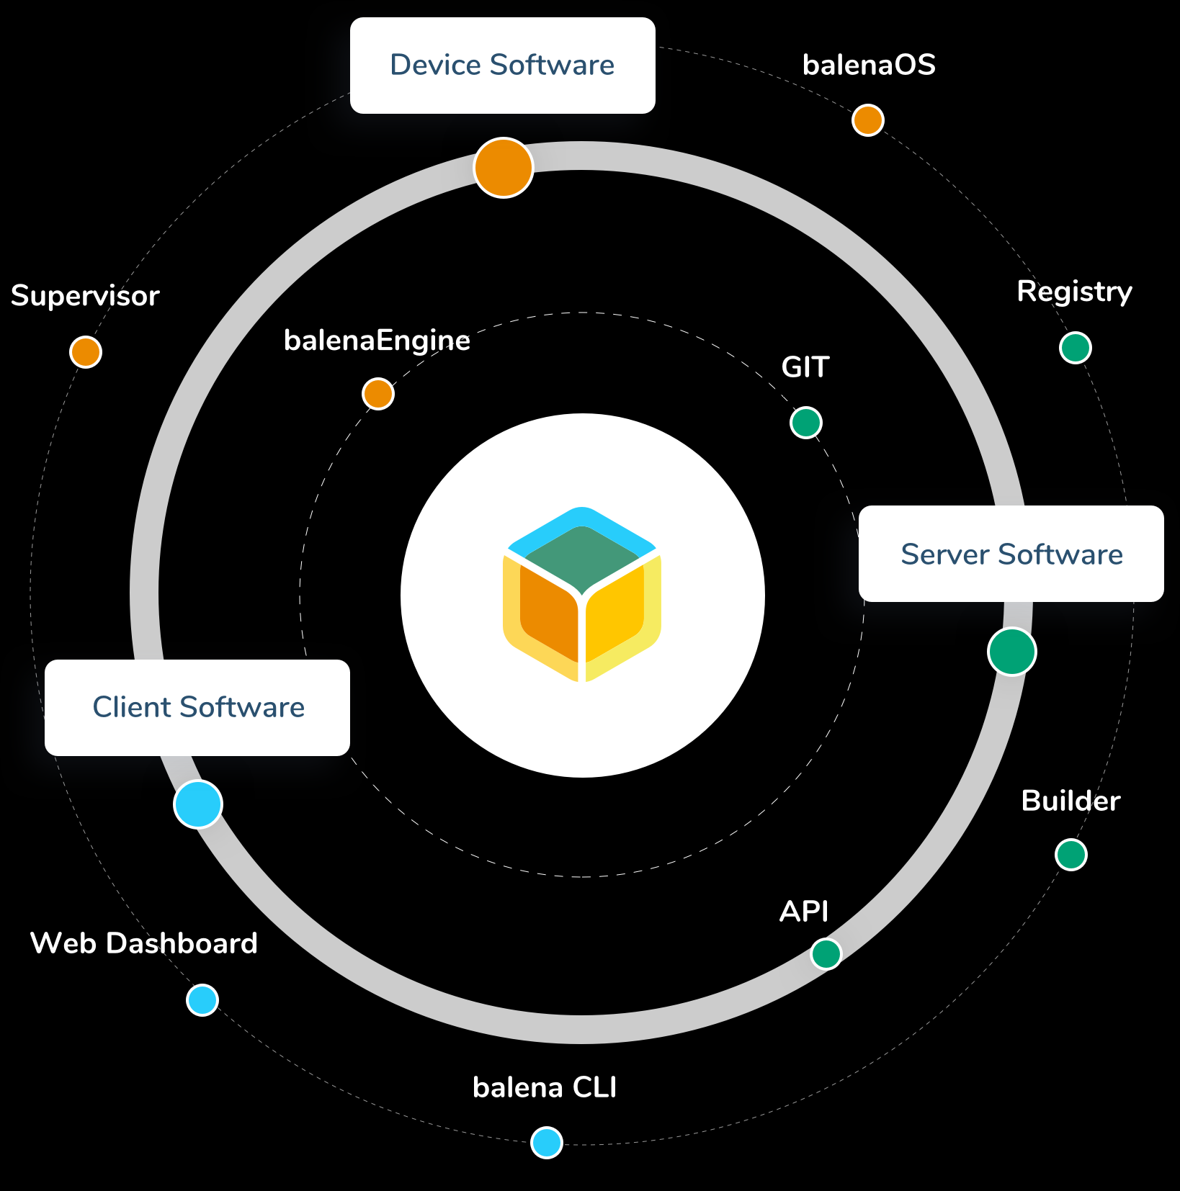
The Balena Ecosystem is Much More...
balenaCloud
balenaHub
balenaFin
EtcherPro
openBalena
balenaEngine
balenaOS
balenaLabs

Slide 4
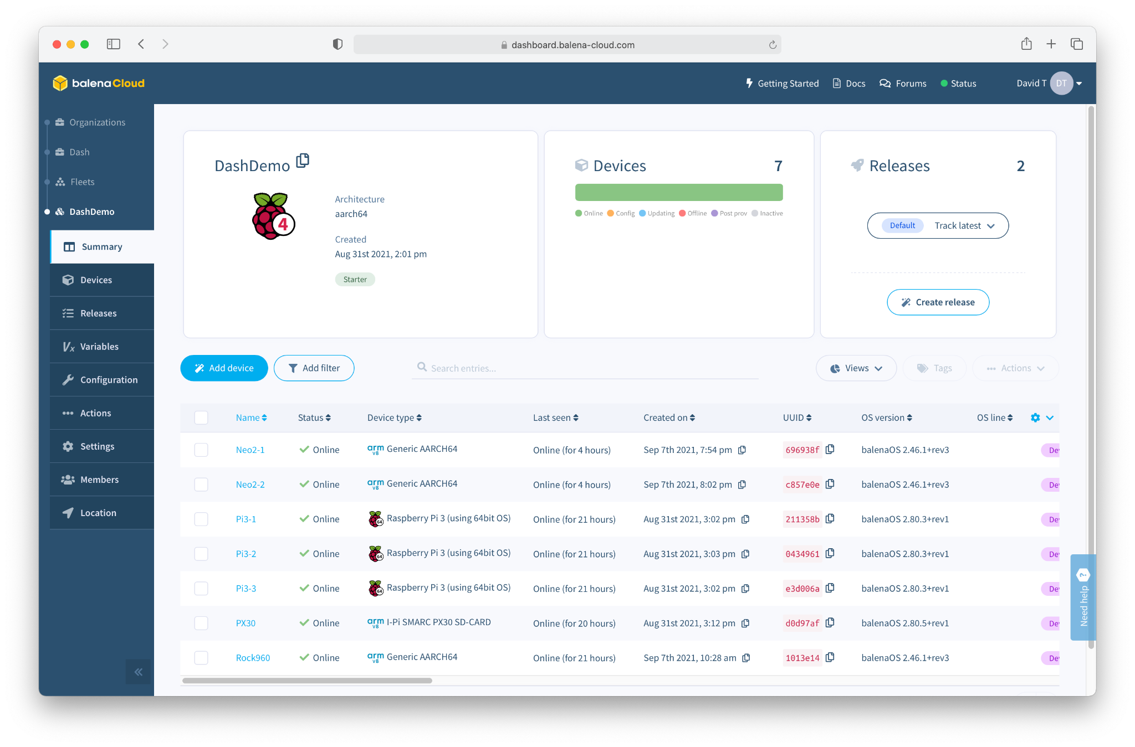
Software
balenaCloud
“Platform built to develop, deploy, and manage fleets of connected devices at scale.”

Slide 5
What do we mean by IoT “Fleet Management”?

Slide 6
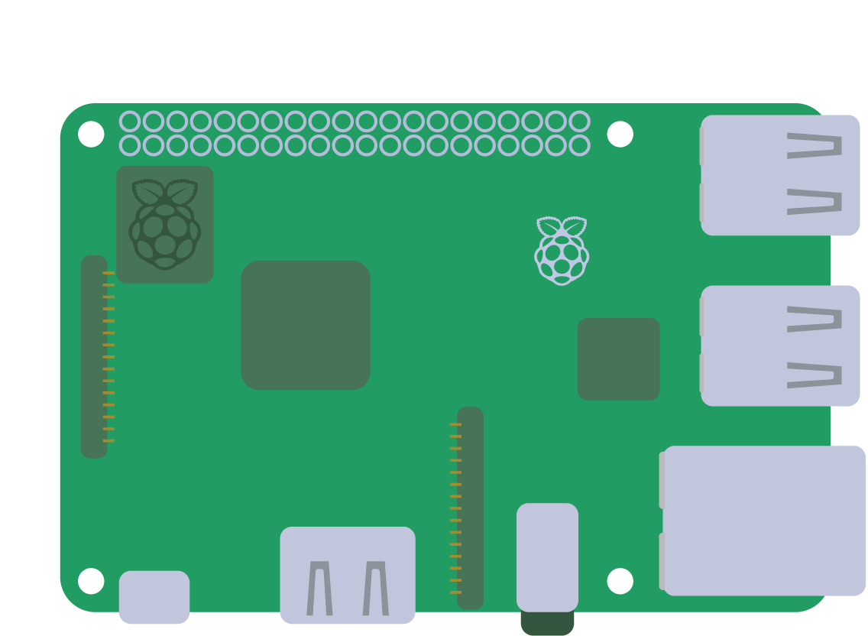


Slide 7
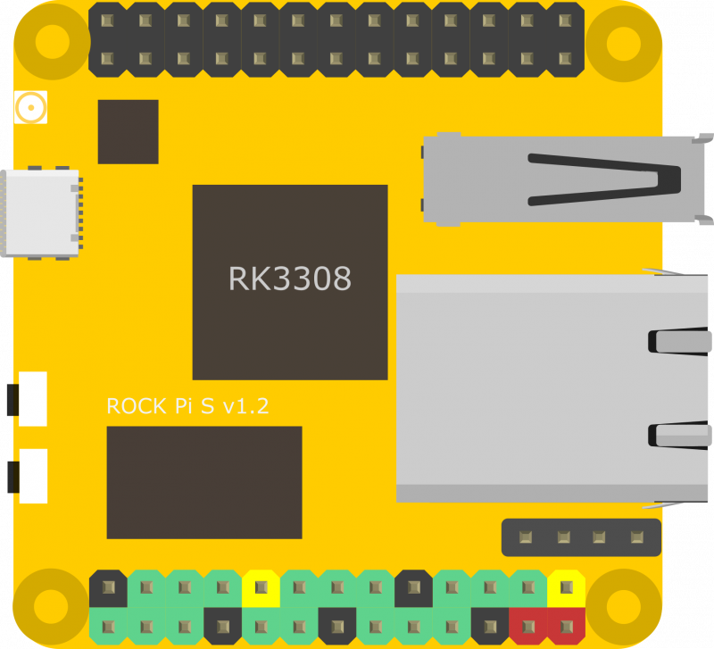
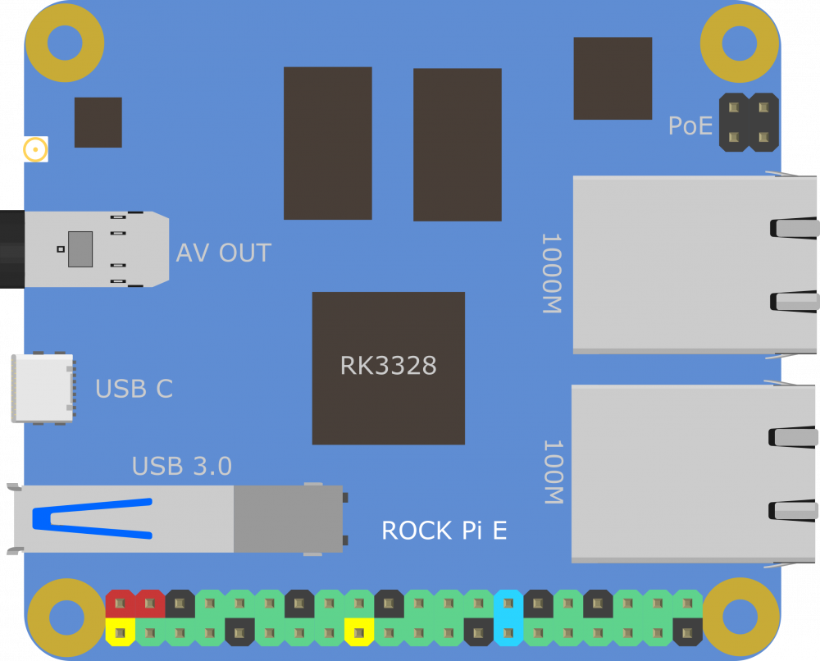
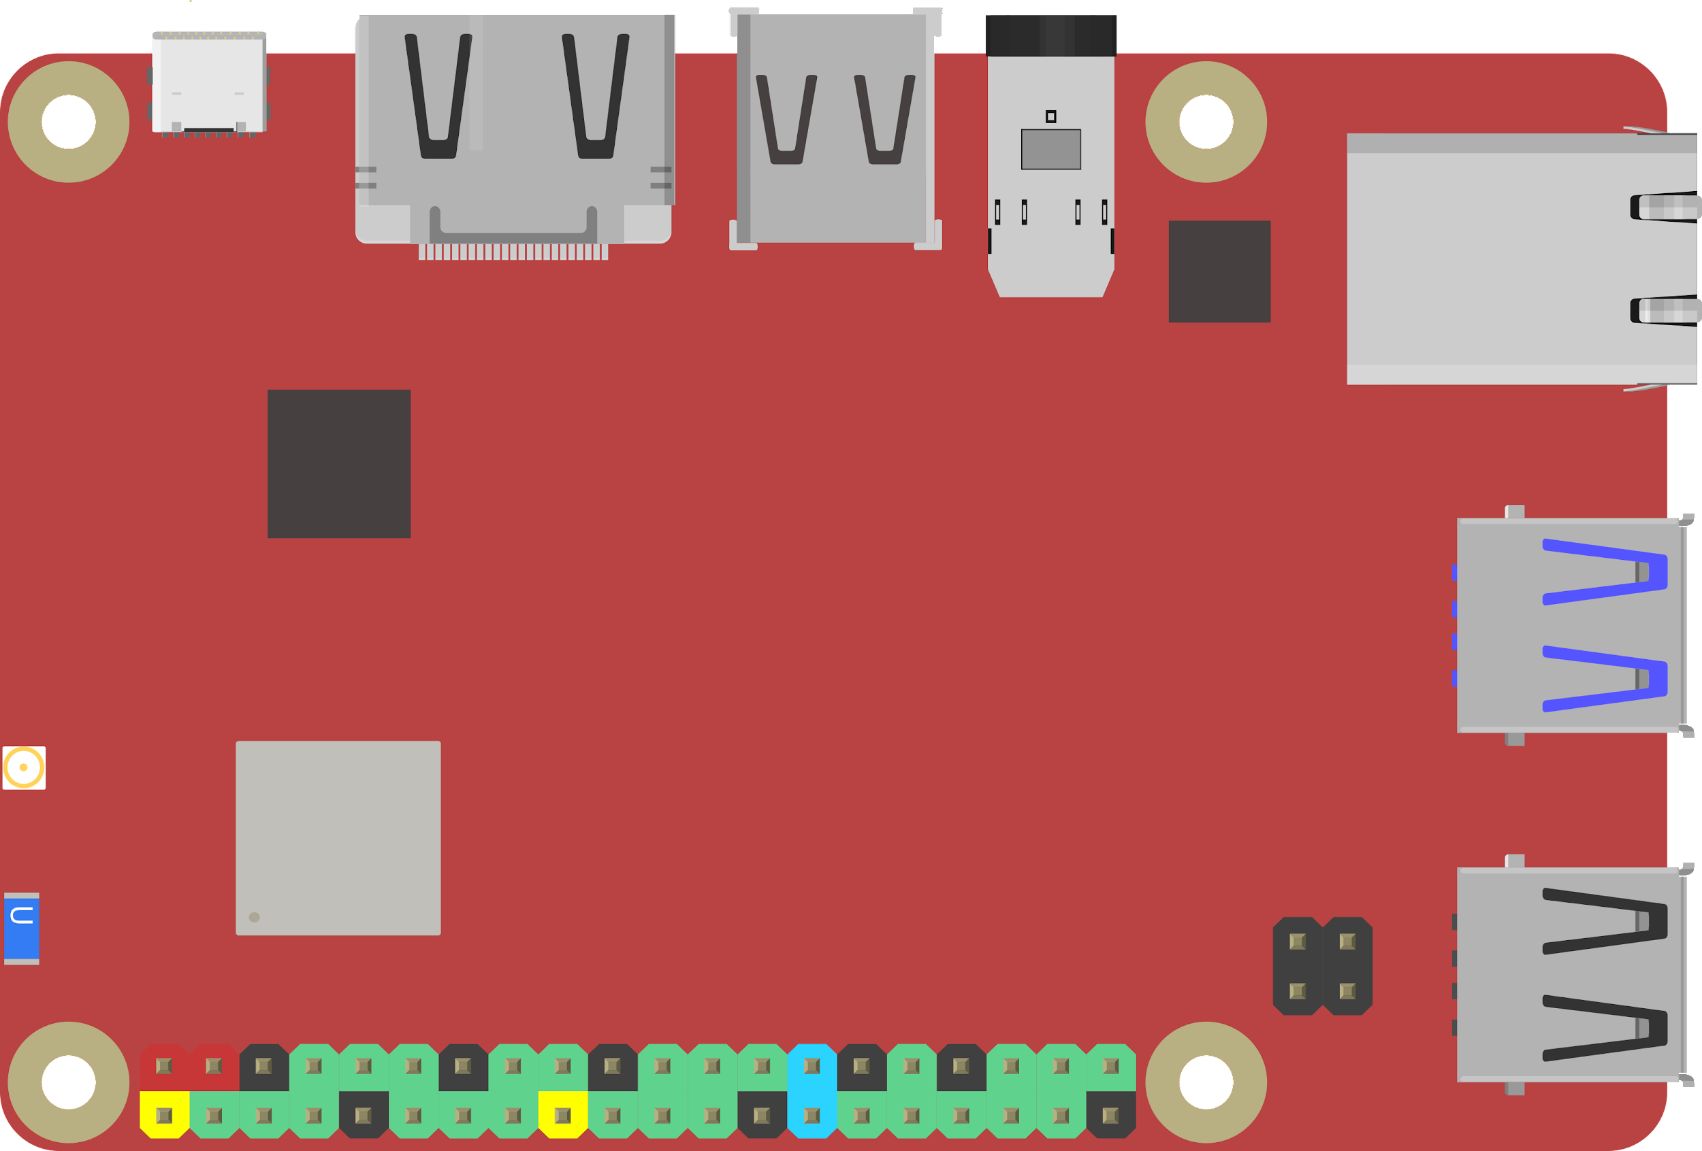
Notes:
48

Slide 8
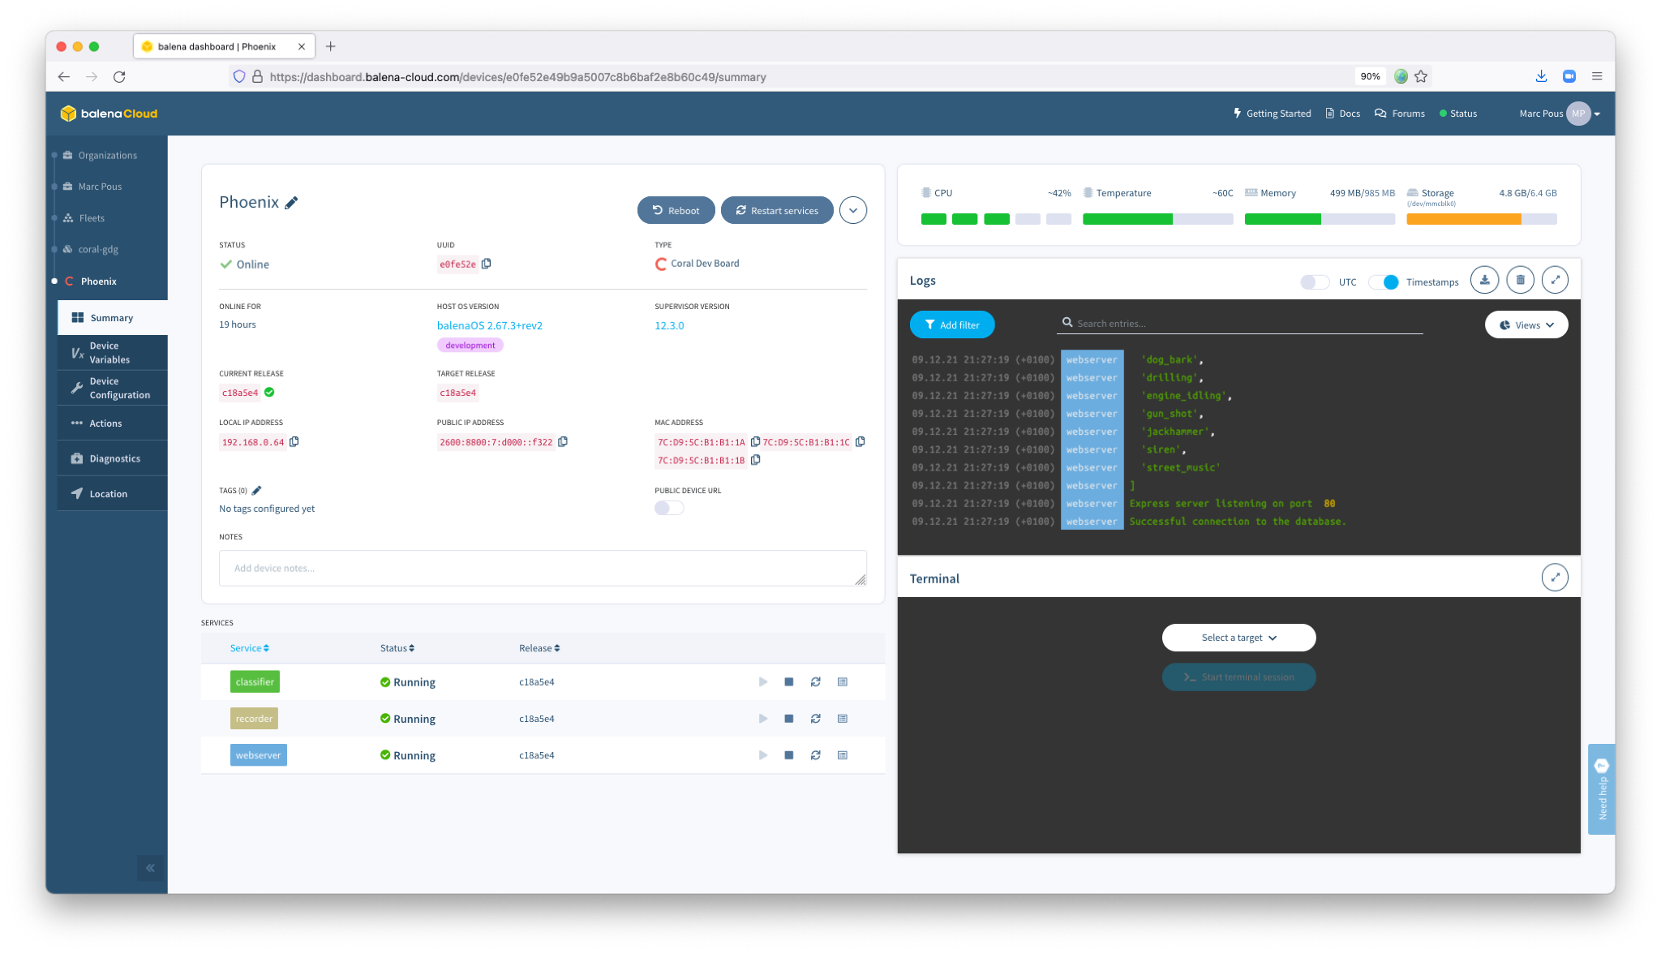

Slide 9
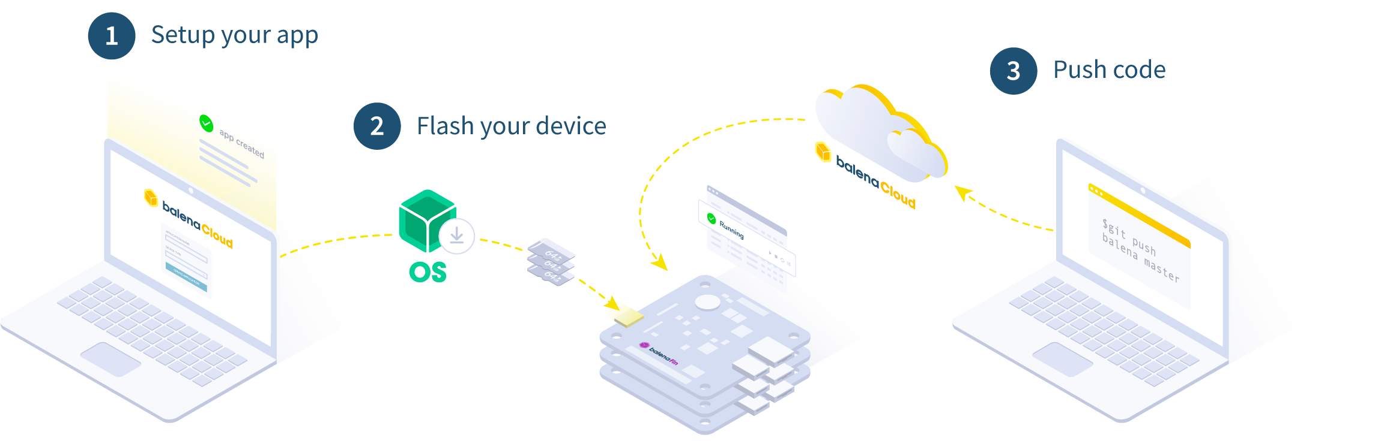
How it works

Slide 10
It’s Easy to Prototype

Slide 11
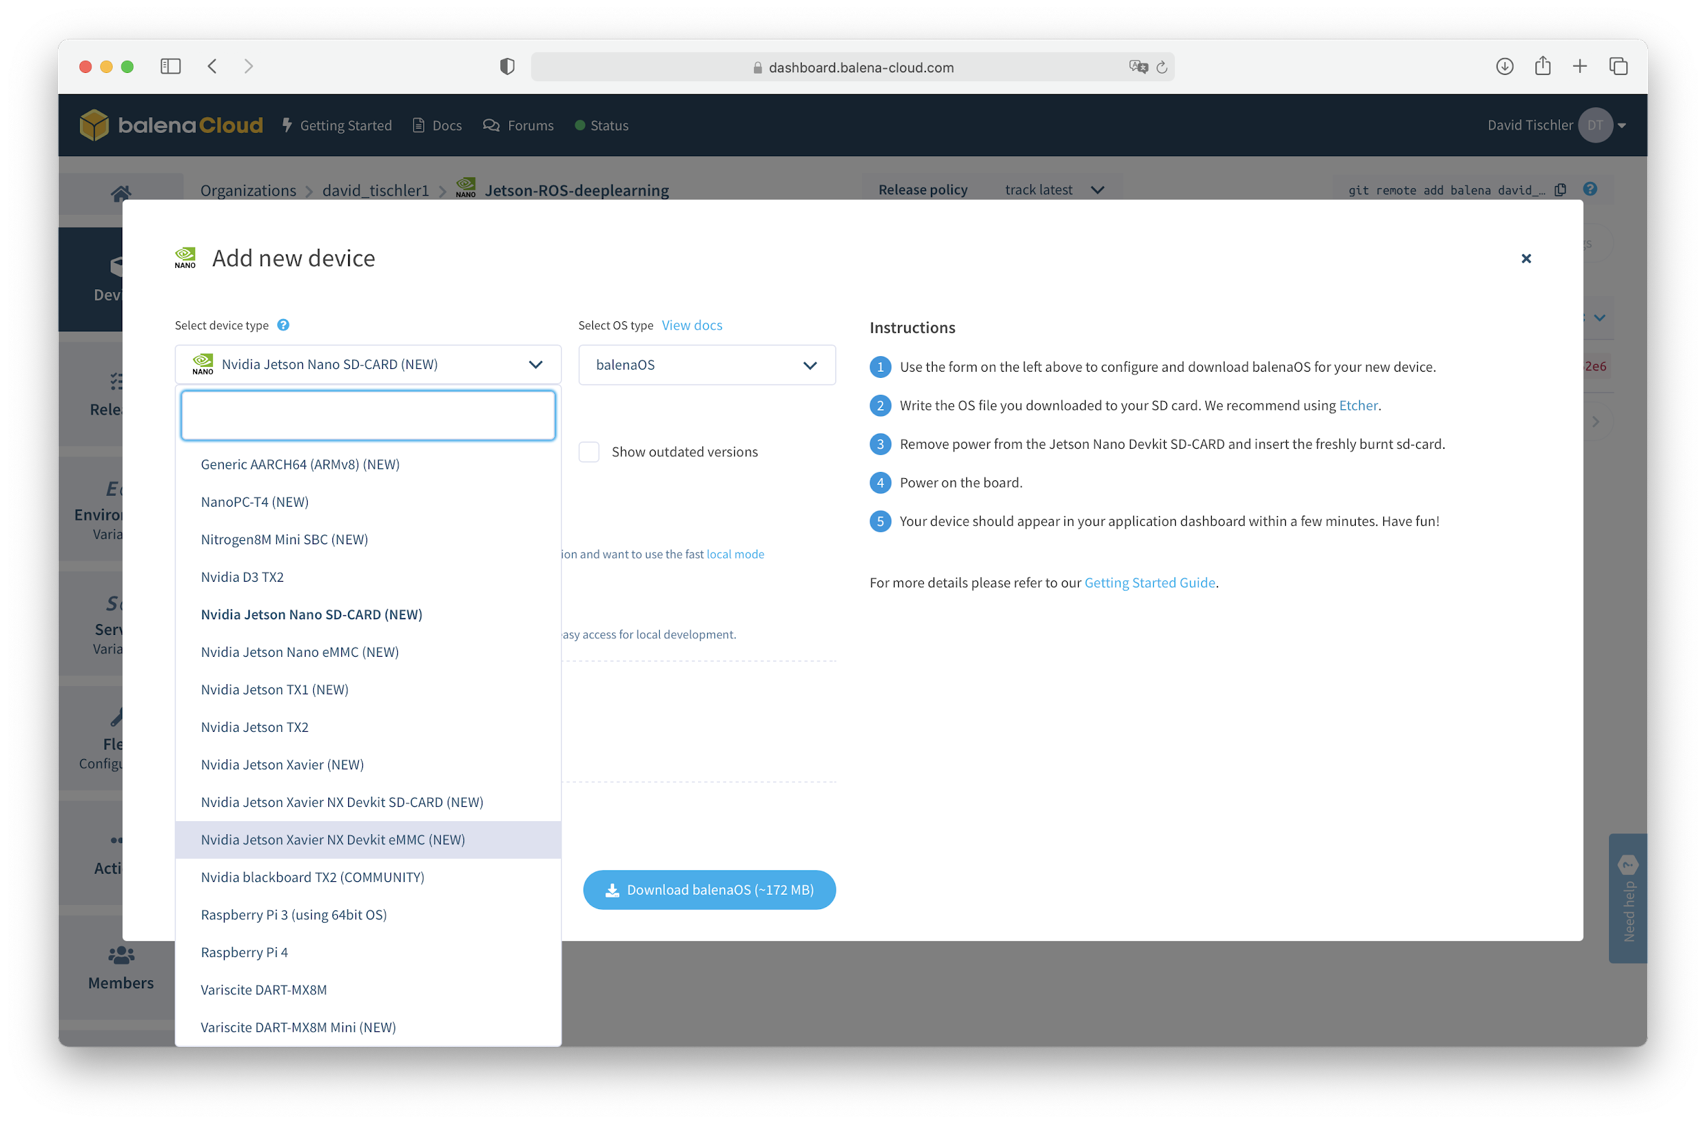

Slide 12
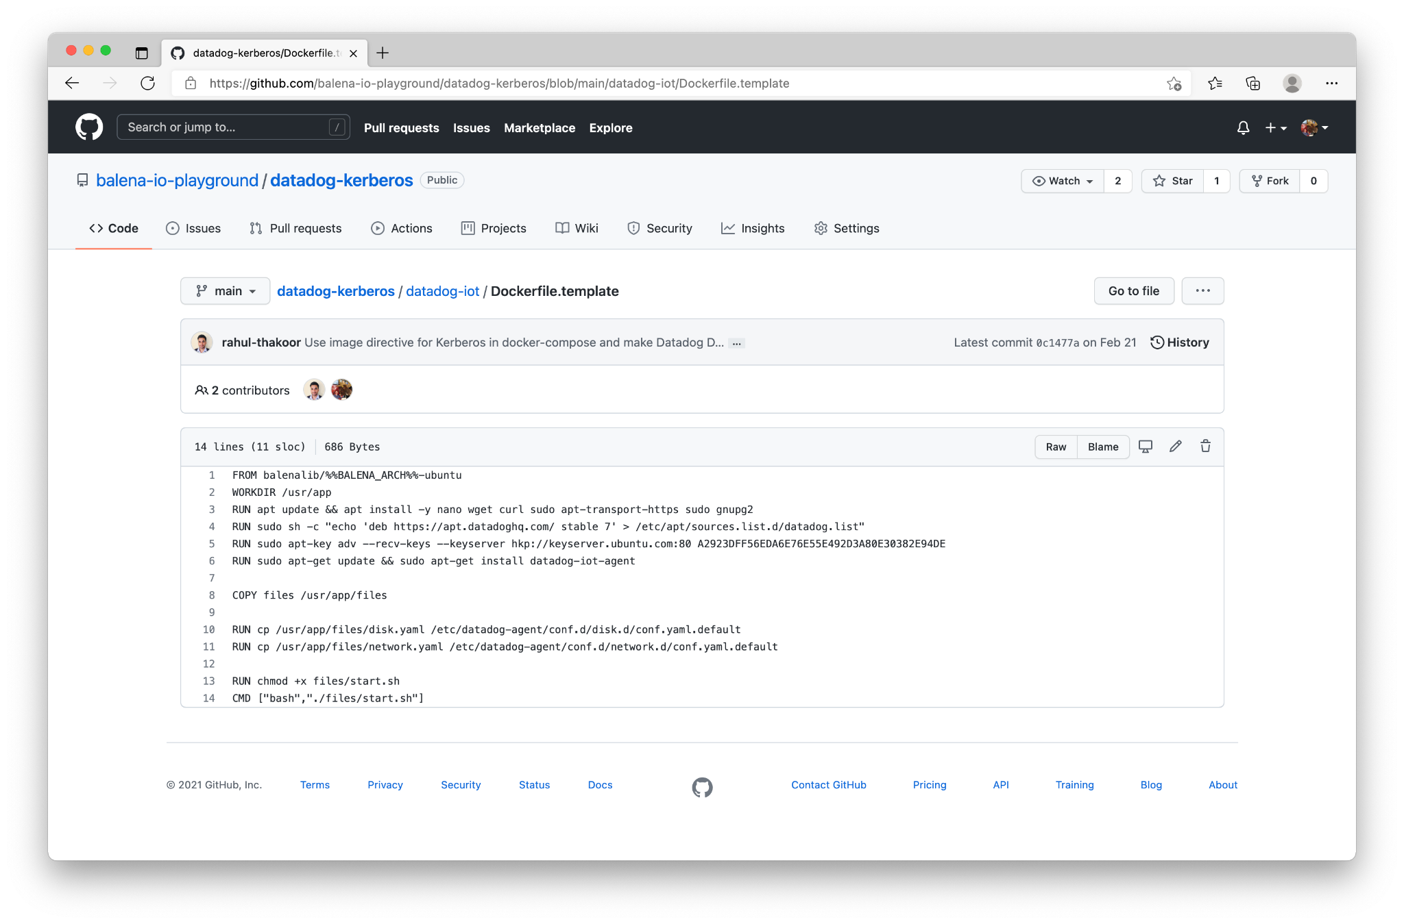

Slide 13
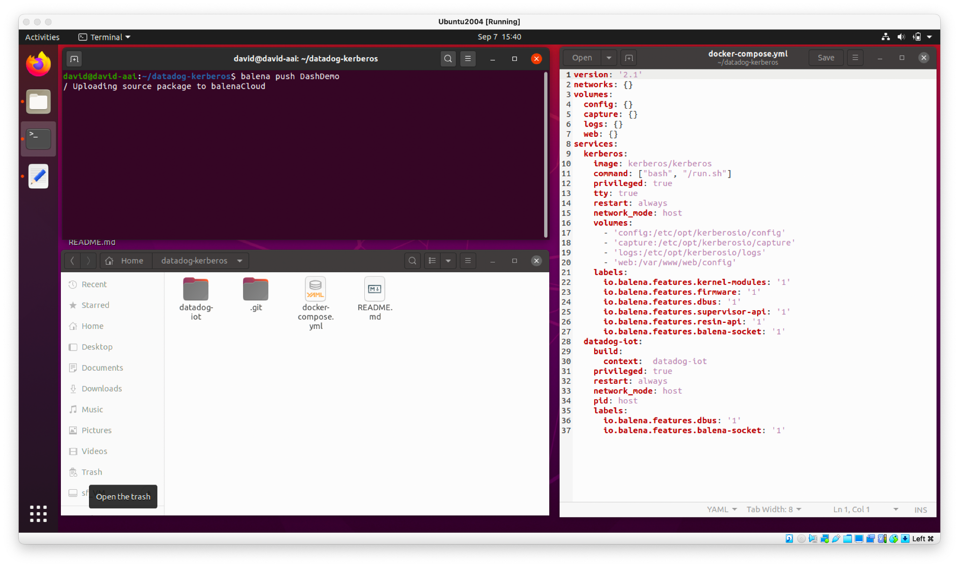
Build and Push Application to Fleet
Use balena CLI to package up application

Slide 14
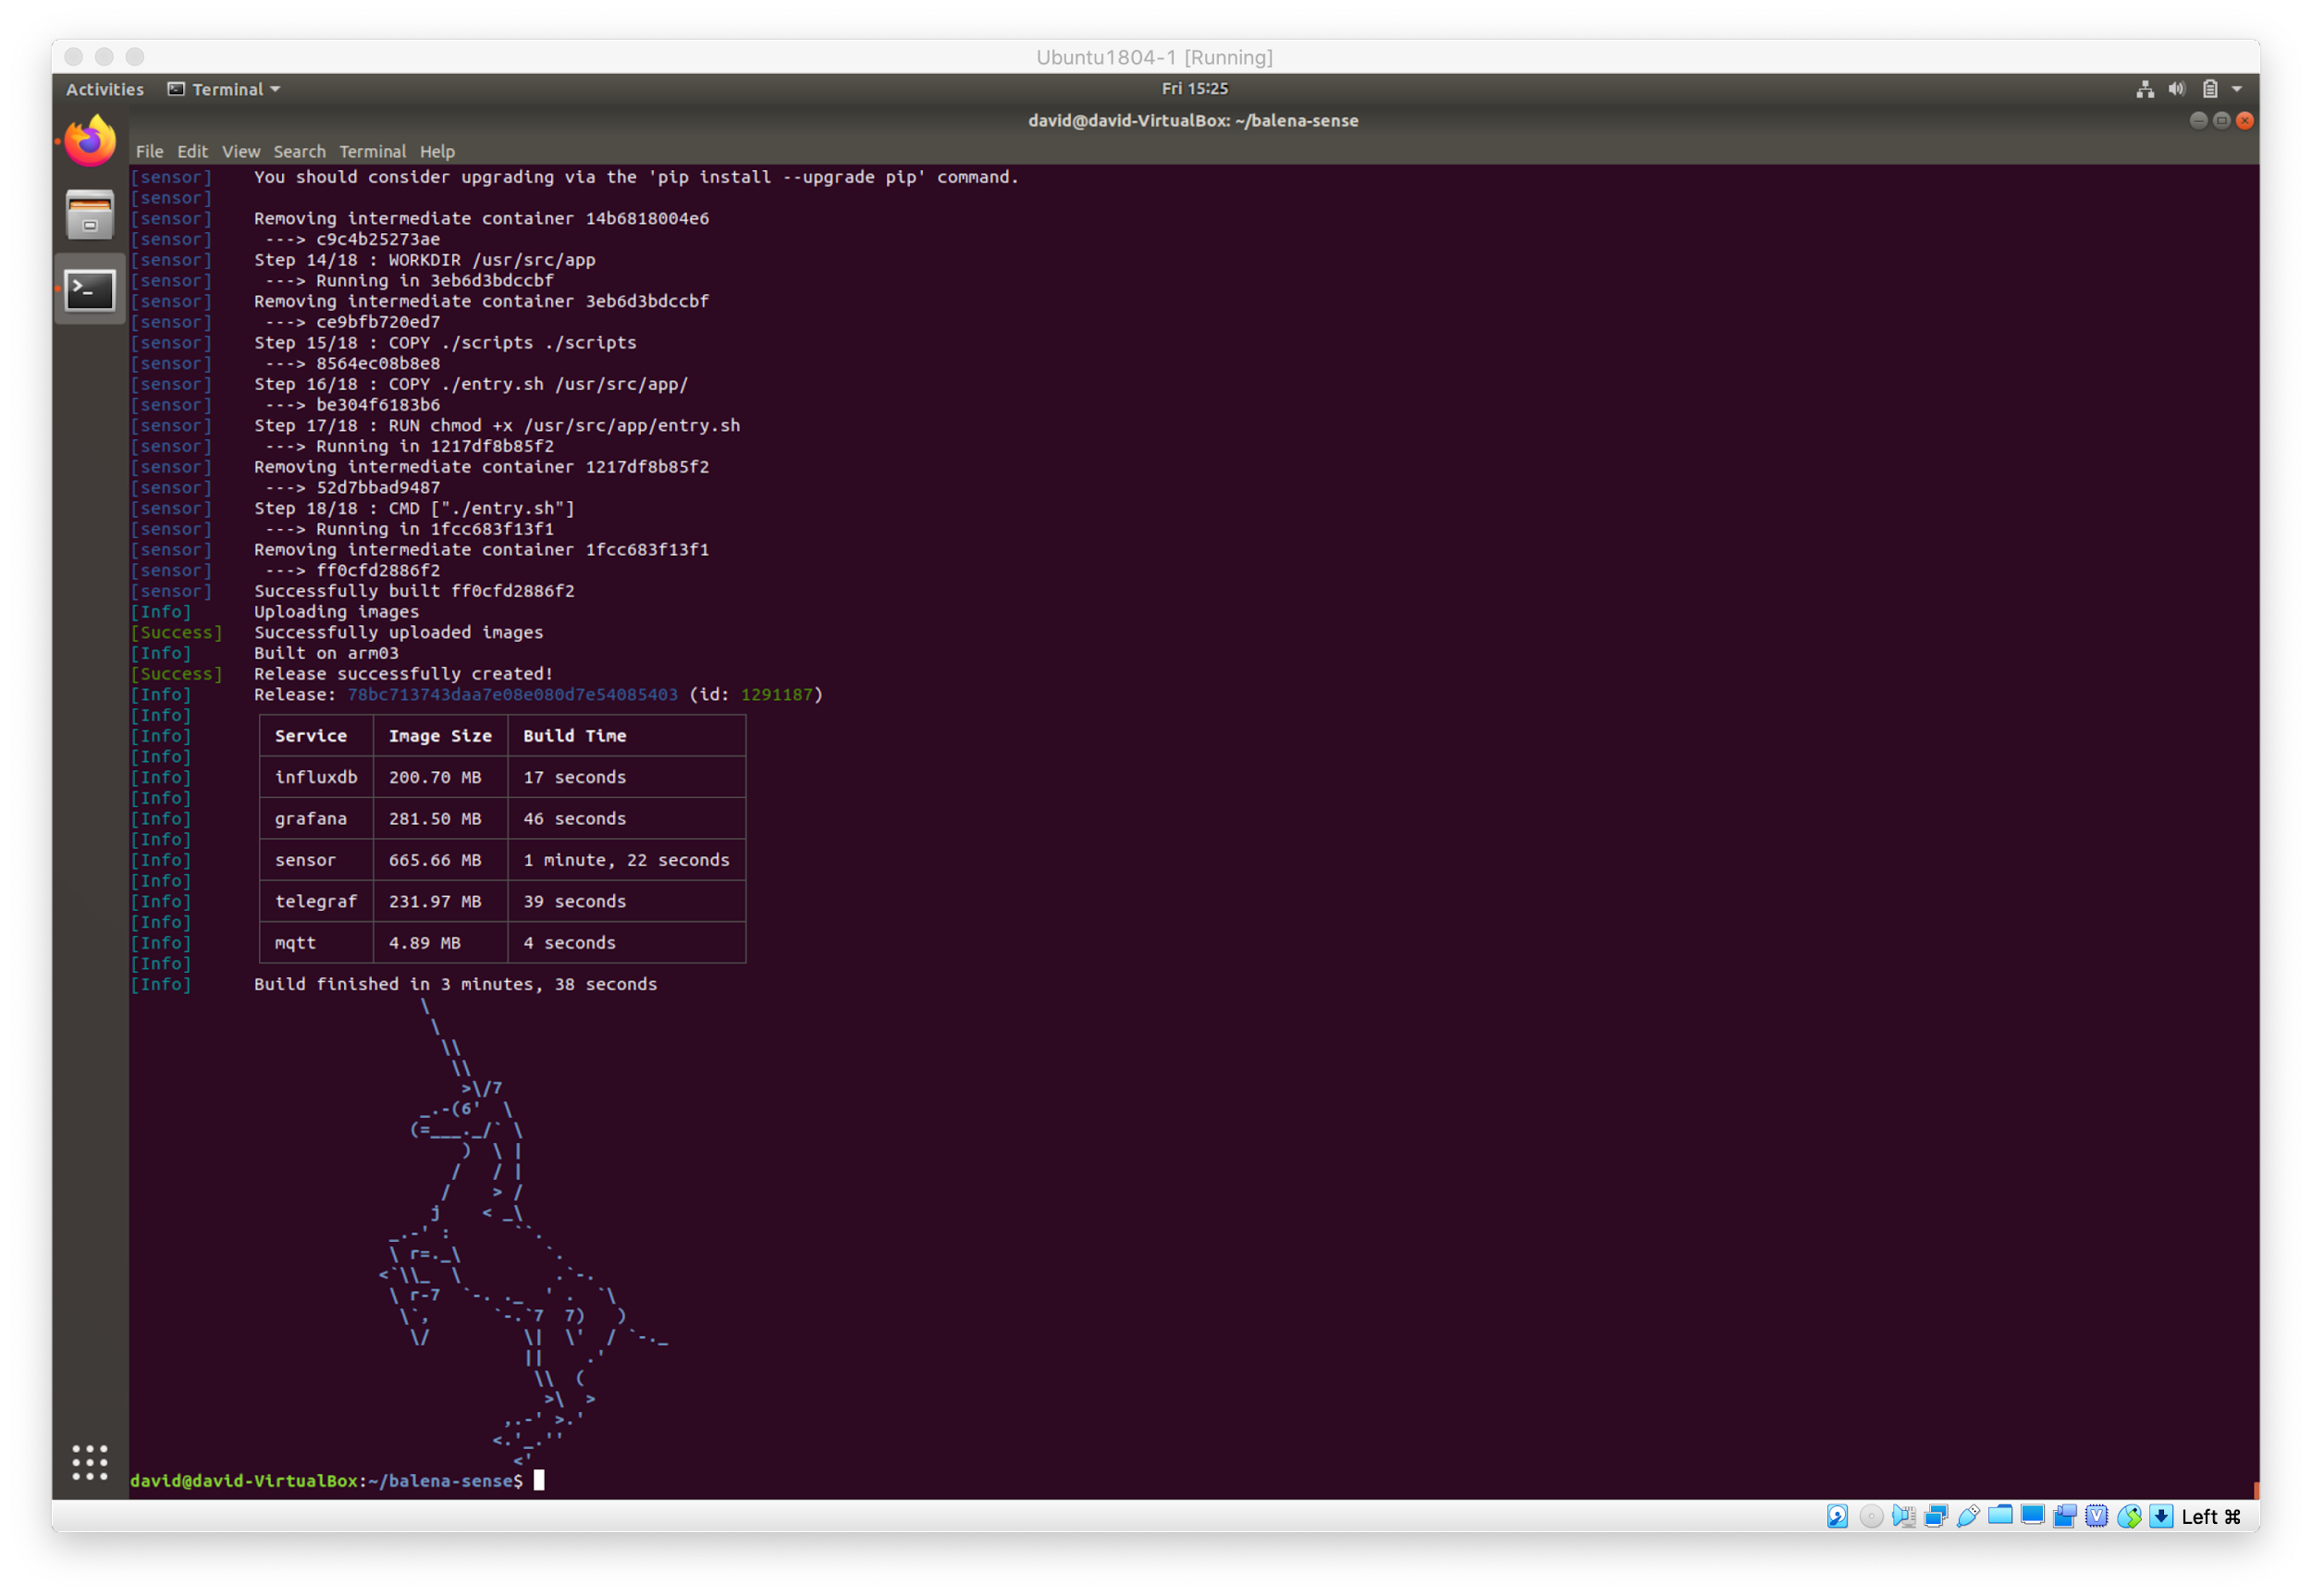
Build and Push Application to Fleet

Slide 15
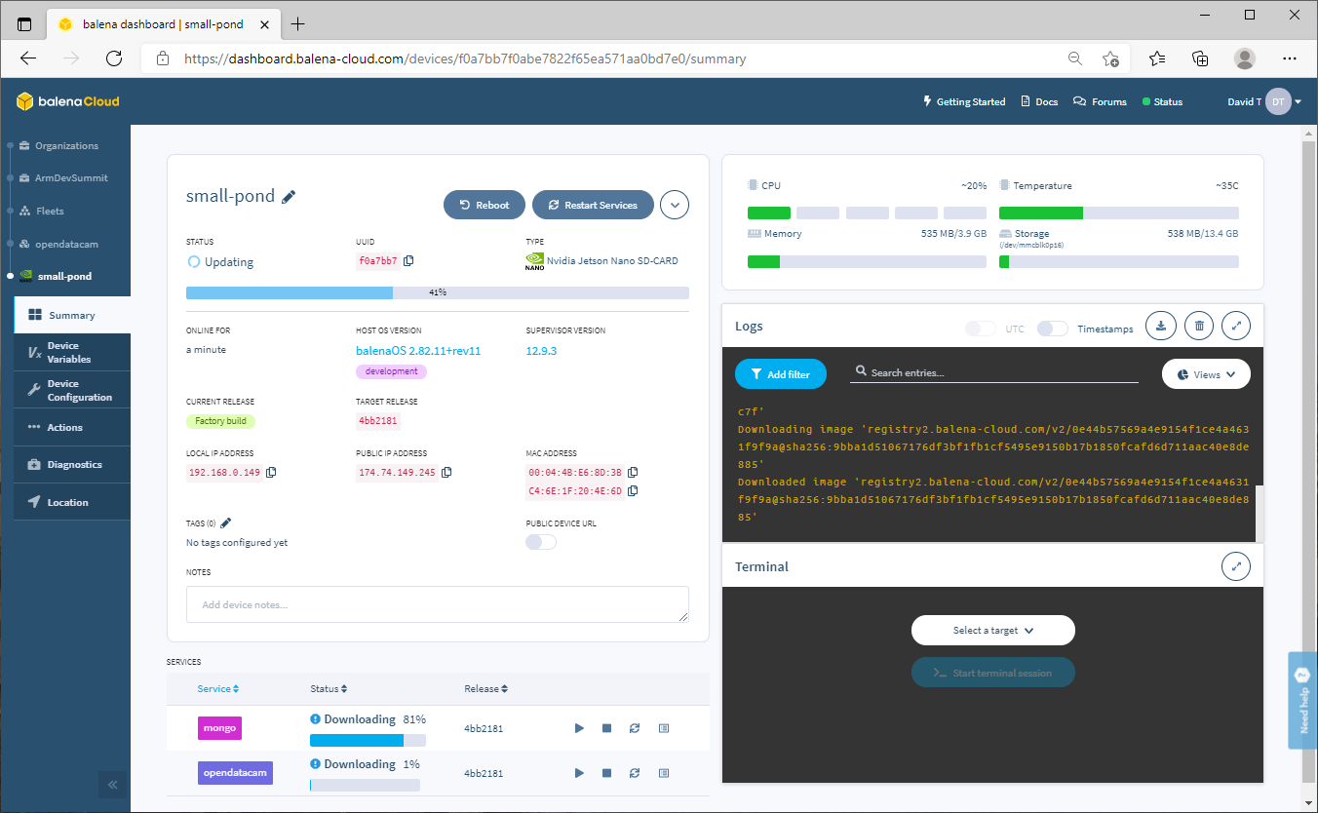

Slide 16
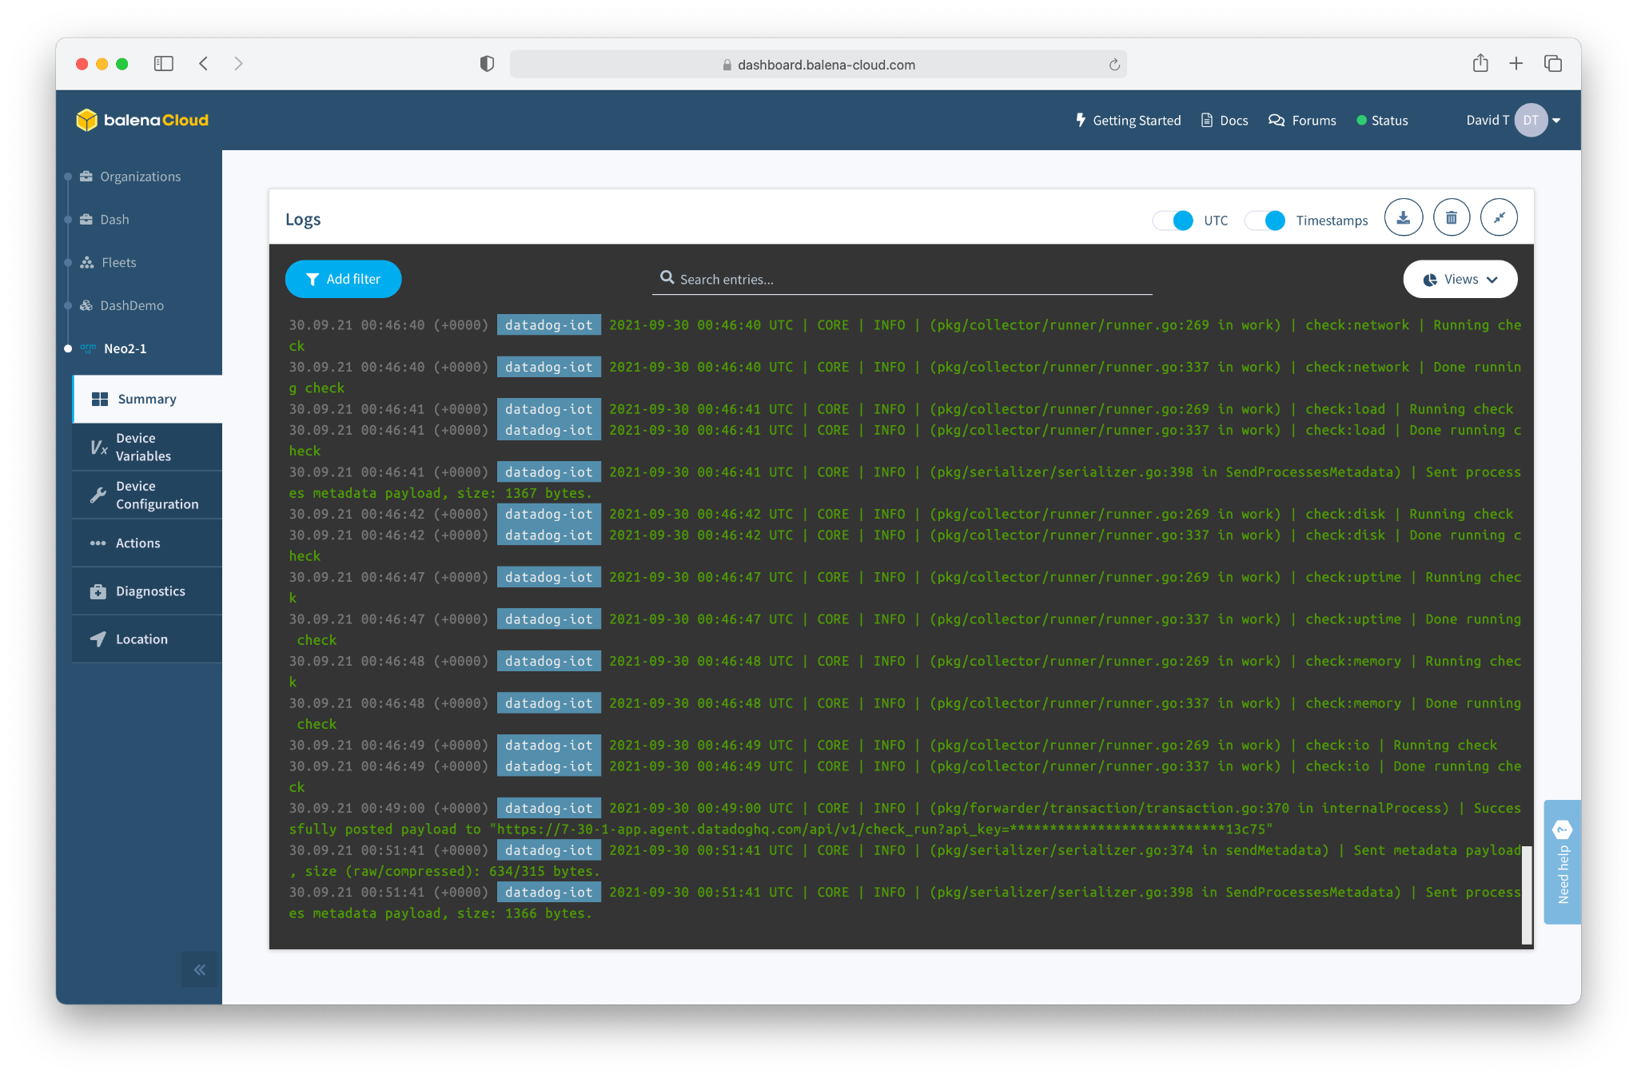

Slide 17
But How Do You Scale?

Slide 19
Just Keep Flashing and Deploying!

Slide 20
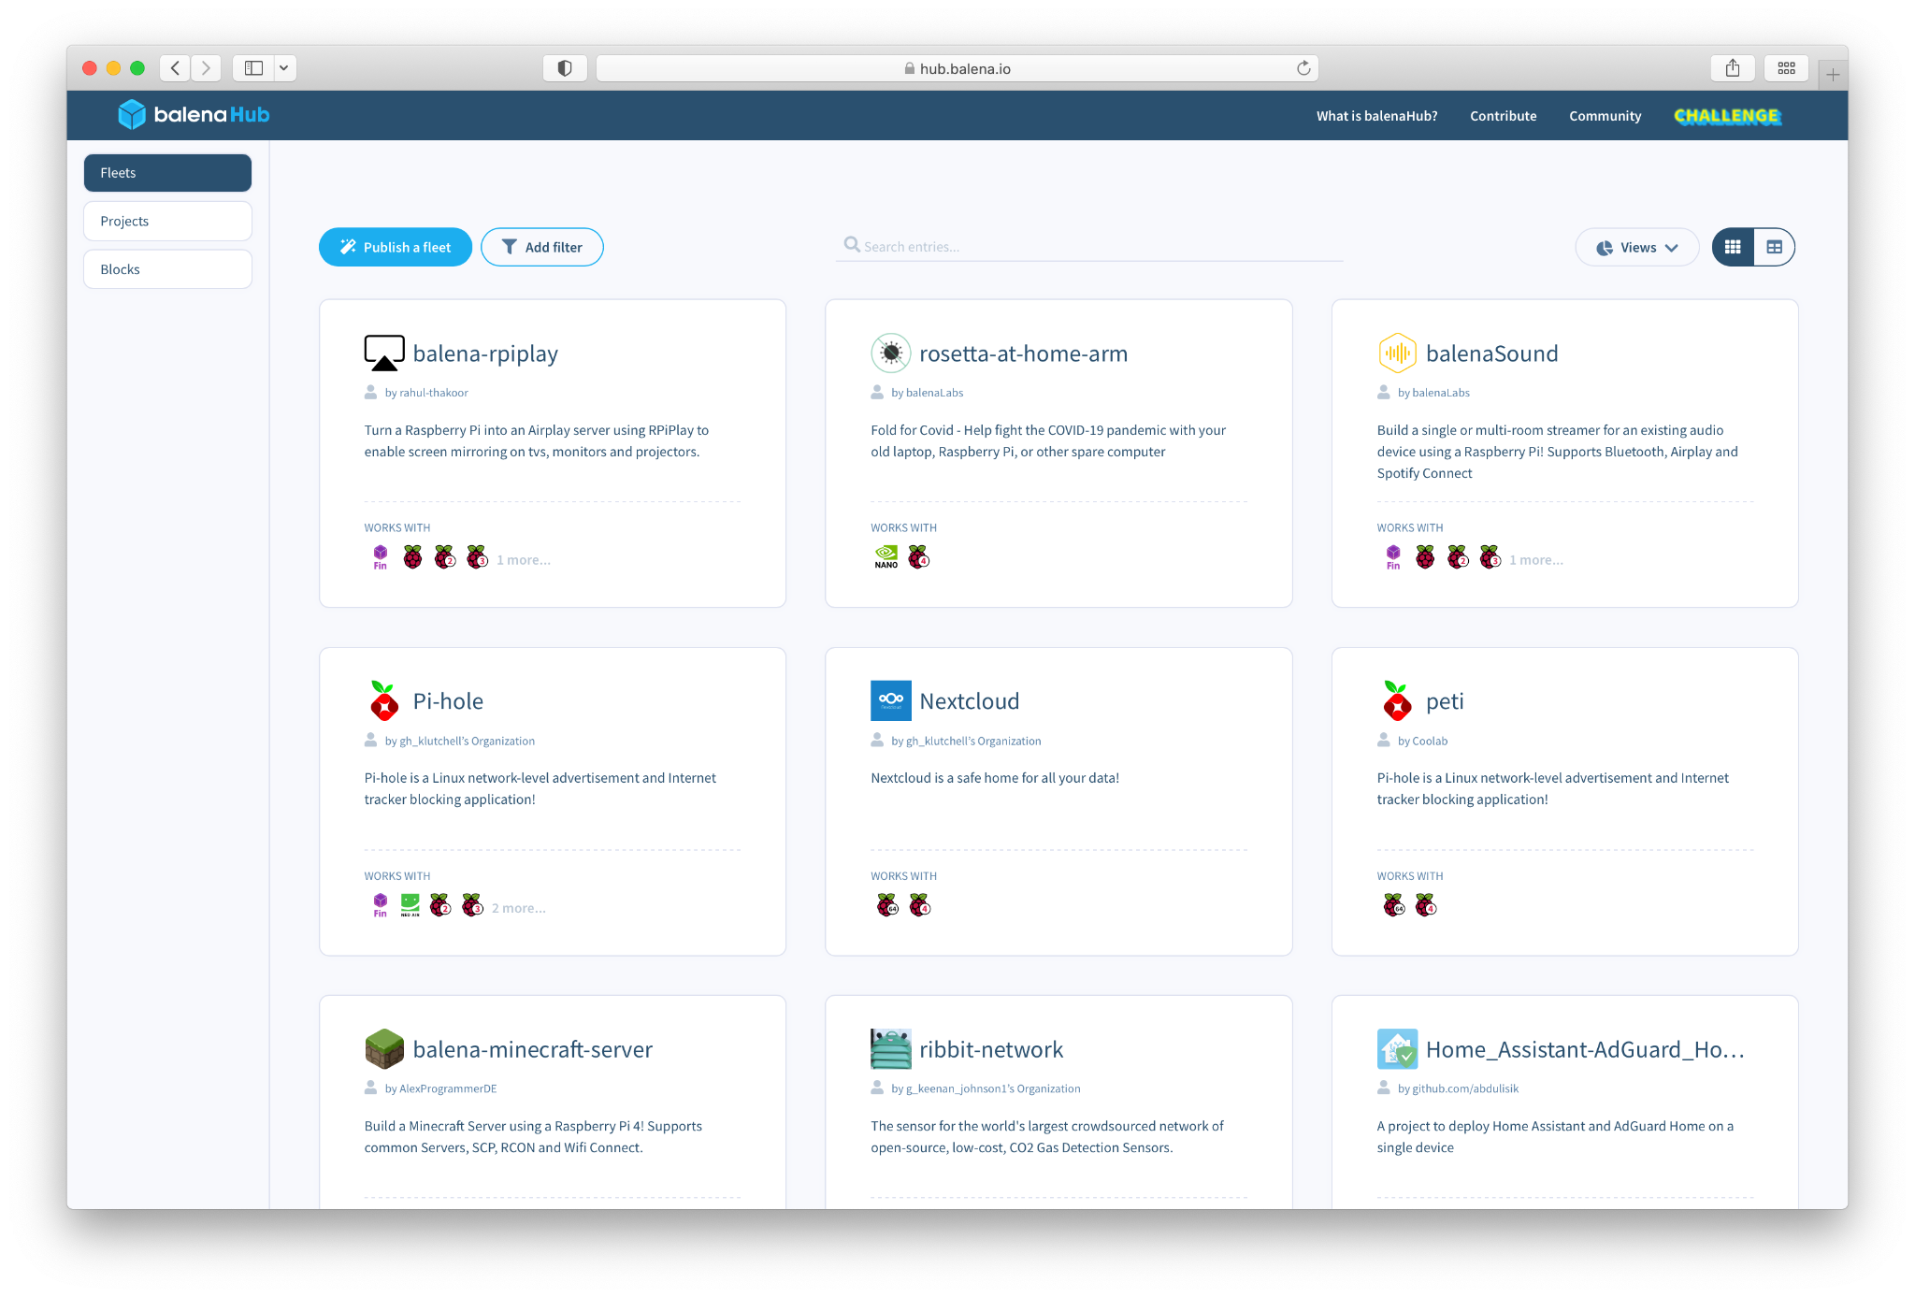
Software
balenaHub
“An easier way to find and publish fleets and projects for edge devices”

Slide 21
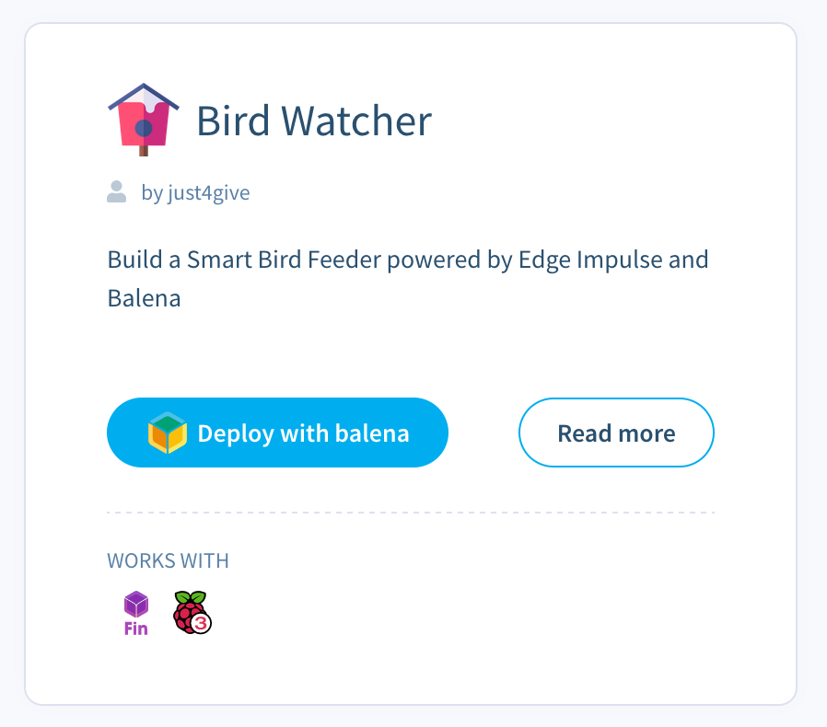
Notes:
Our stack addresses pain points that inhibit entry to the field
We have created the technology that can bootstrap an industry
We need a way to get it into the hands of the users
Allow people to build upon our learnings and avoid starting from scratch
---
Lower the barrier to entry
Give everyone the tools necessary to succeed in this space
Provide a smooth path from beginner to a successful app/business
Allow more fleet owners to get started; make more ideas viable - who knows what people will come up with
It’s hard to explore and test ideas
---
Initiate an exponential growth process
Build positive feedback loops
Seed and cultivate network effects and virality, between devices as well
Encourage and facilitate contribution
Expose us to more fleet owners (including potential fleet owners)

Slide 22
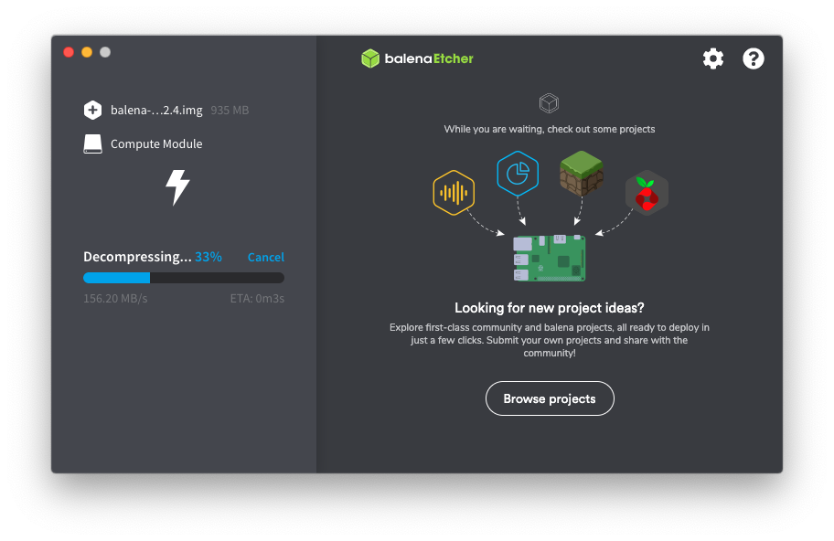
Notes:
Our stack addresses pain points that inhibit entry to the field
We have created the technology that can bootstrap an industry
We need a way to get it into the hands of the users
Allow people to build upon our learnings and avoid starting from scratch
---
Lower the barrier to entry
Give everyone the tools necessary to succeed in this space
Provide a smooth path from beginner to a successful app/business
Allow more fleet owners to get started; make more ideas viable - who knows what people will come up with
It’s hard to explore and test ideas
---
Initiate an exponential growth process
Build positive feedback loops
Seed and cultivate network effects and virality, between devices as well
Encourage and facilitate contribution
Expose us to more fleet owners (including potential fleet owners)

Slide 23
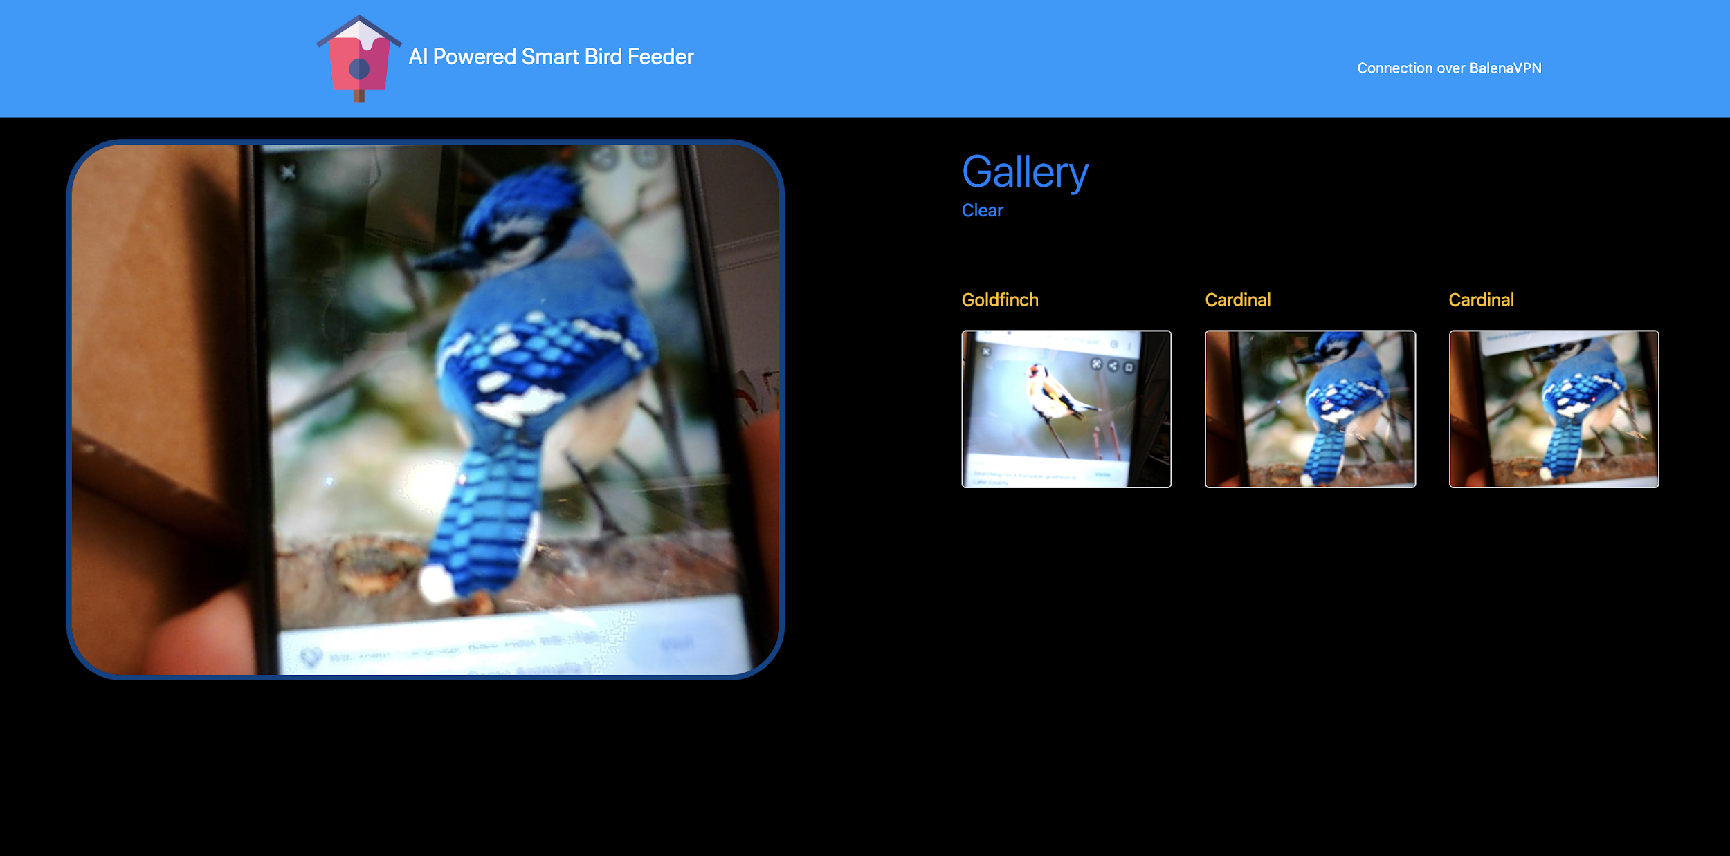
Notes:
Our stack addresses pain points that inhibit entry to the field
We have created the technology that can bootstrap an industry
We need a way to get it into the hands of the users
Allow people to build upon our learnings and avoid starting from scratch
---
Lower the barrier to entry
Give everyone the tools necessary to succeed in this space
Provide a smooth path from beginner to a successful app/business
Allow more fleet owners to get started; make more ideas viable - who knows what people will come up with
It’s hard to explore and test ideas
---
Initiate an exponential growth process
Build positive feedback loops
Seed and cultivate network effects and virality, between devices as well
Encourage and facilitate contribution
Expose us to more fleet owners (including potential fleet owners)

Slide 24
Software
Etcher
“A cross-platform tool to flash OS images onto SD cards and USB drives safely and easily.”

Slide 25
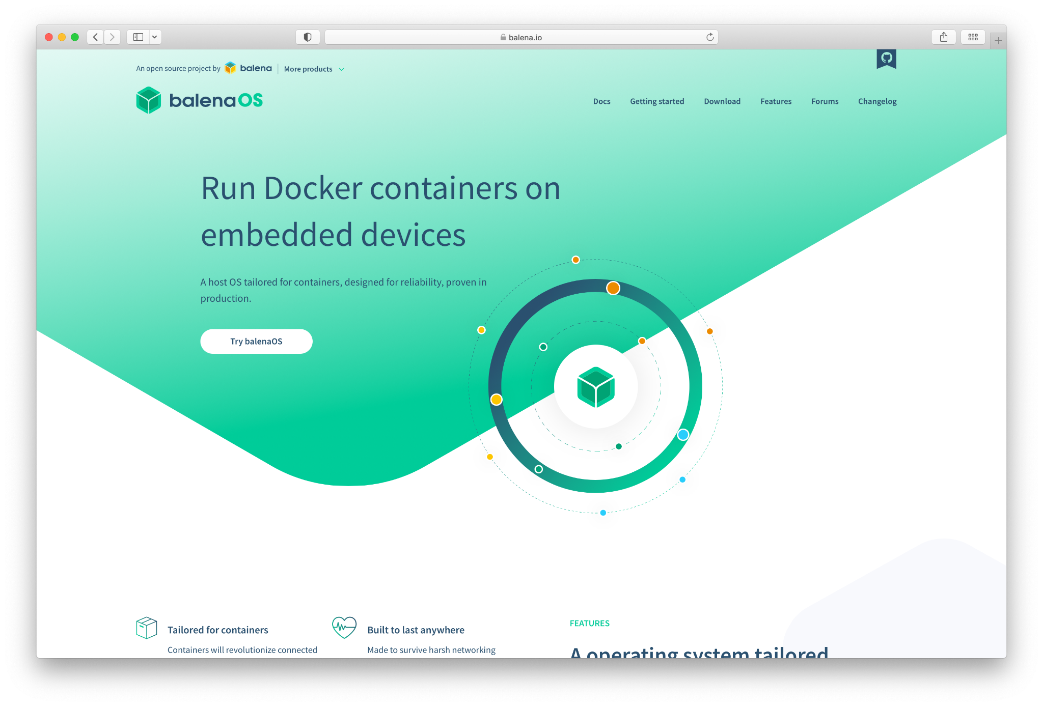
Software
balenaEngine
Open source container runtime based upon Moby
balenaOS
Open source IoT operating system based on Yocto

Slide 26
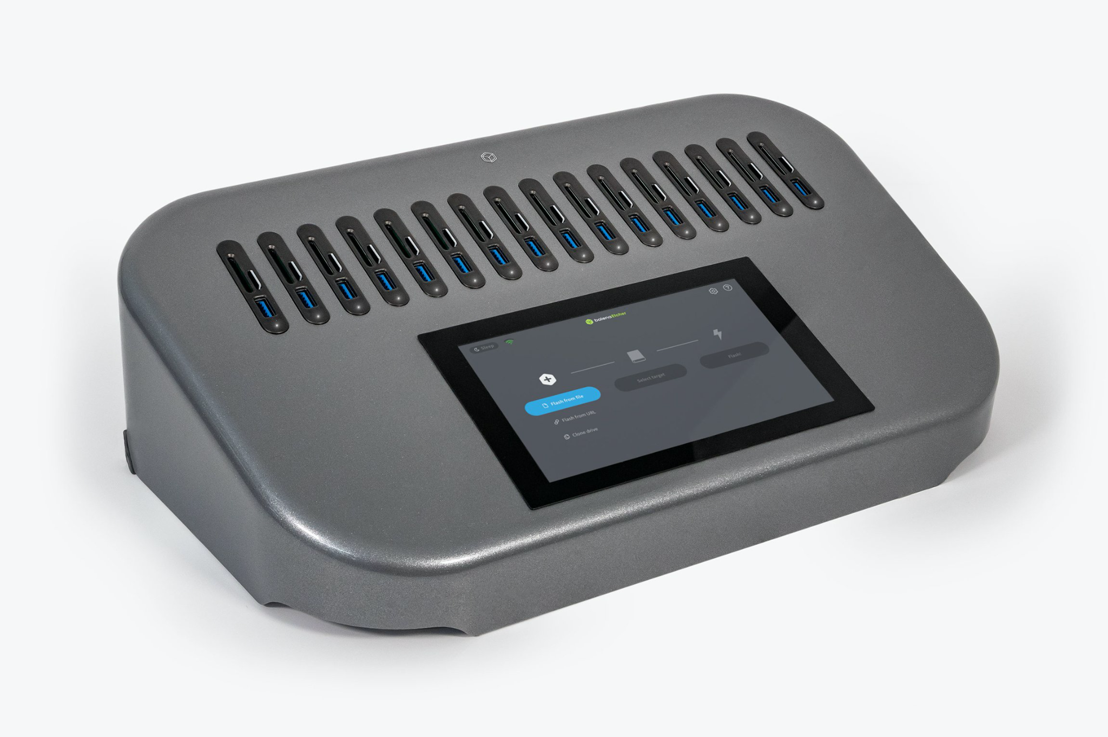
Hardware
EtcherPro
“Built to write data flawlessly to multiple devices simultaneously”

Slide 27
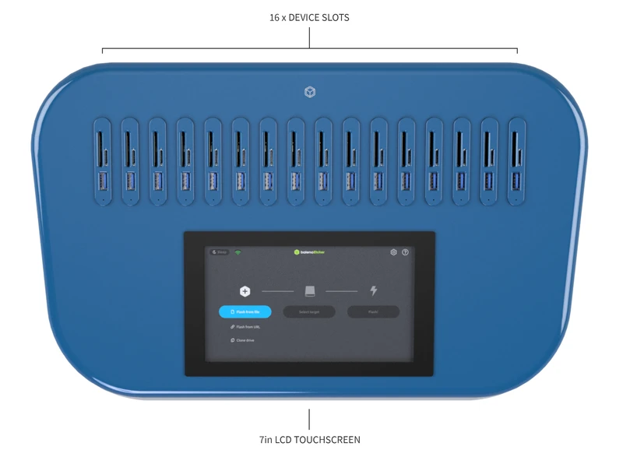
Hardware
EtcherPro
Flash up to 16 drives / devices at once
Flash at speeds up to 52MB/s when flashing 16 drives/devices simultaneously, or up to 200MB/s for a single drive/device
Support SD, microSD, USB drives, and single-board computers (or compute modules via carrier boards)

Slide 28
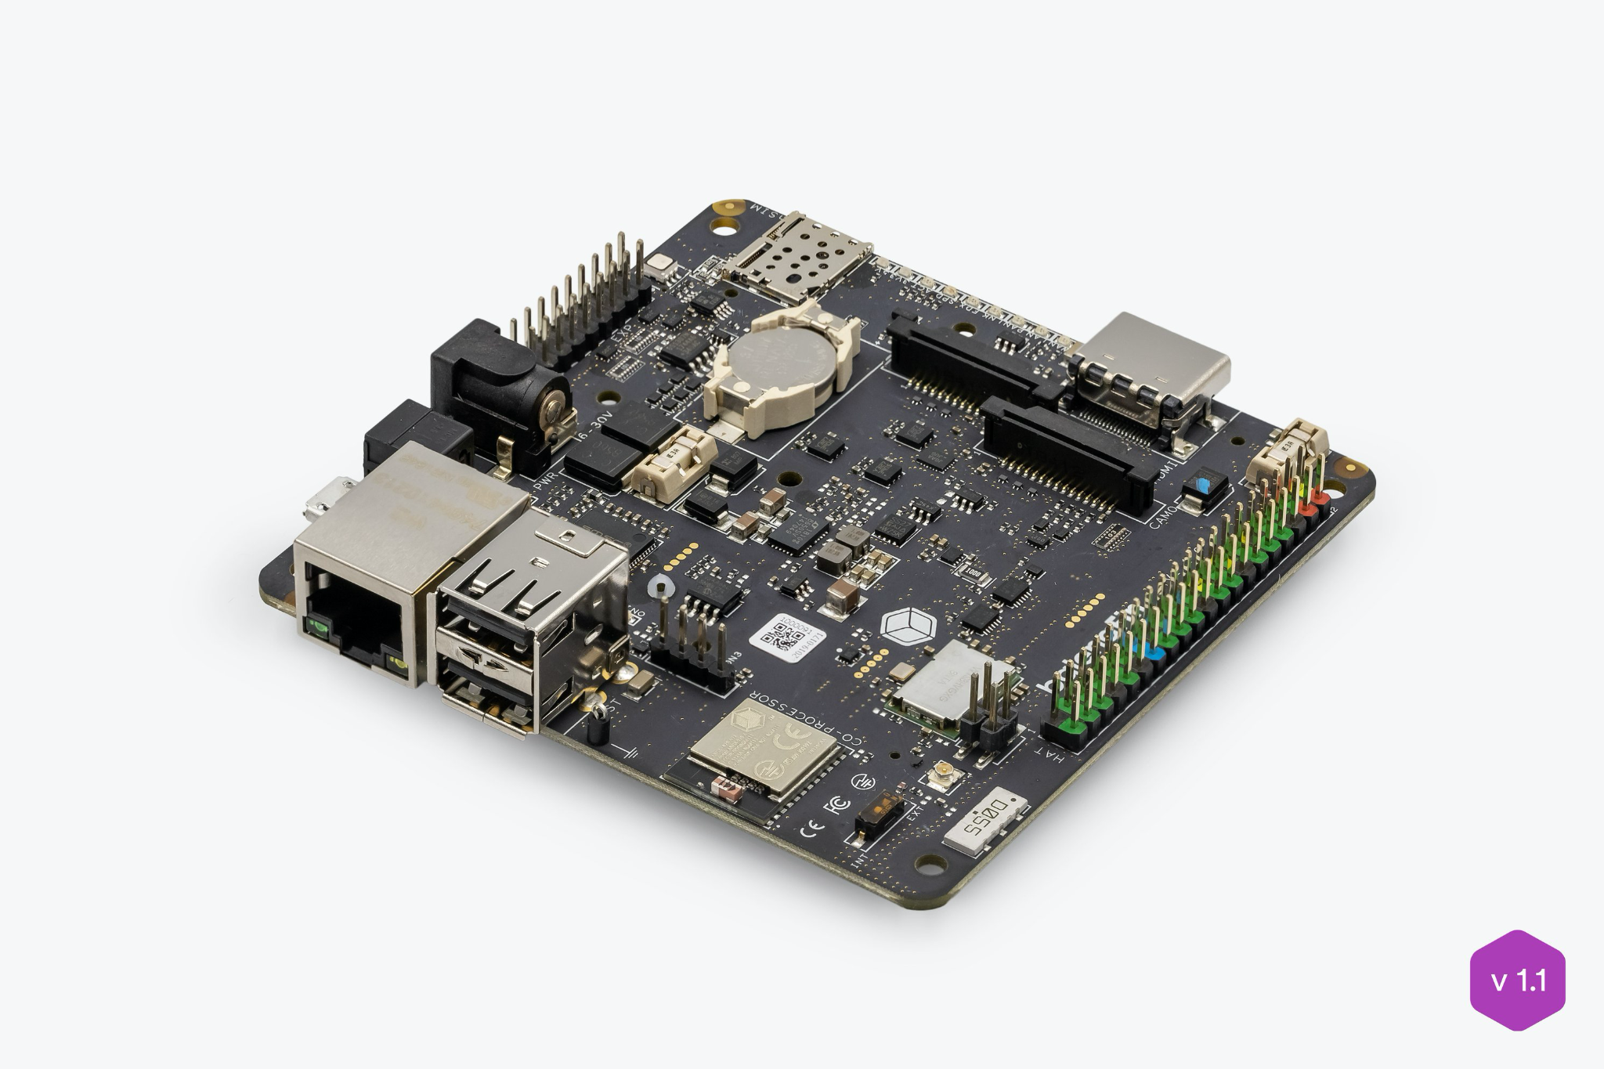
Hardware
balenaFin
“A professional carrier board for the Raspberry Pi Compute Module”

Slide 29
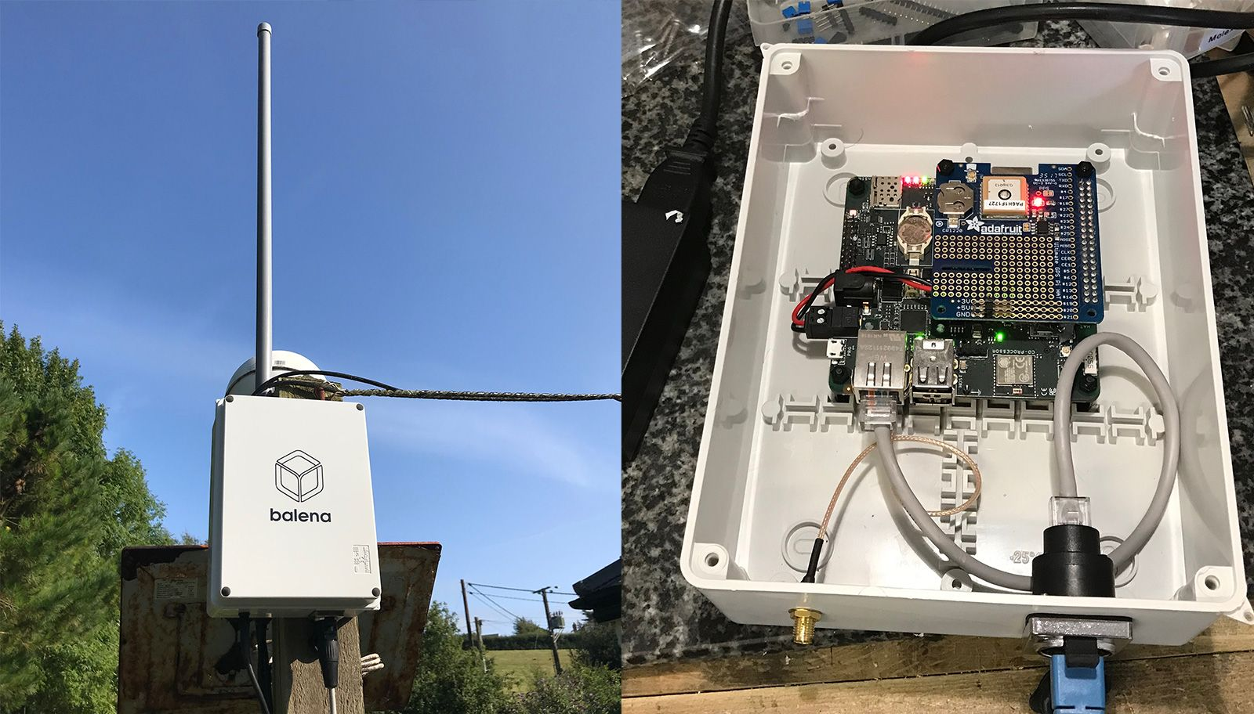
Hardware
balenaFin
“A Raspberry Pi Compute Module carrier board that can run all the software that the Raspberry Pi can run, but hardened for deployment in the field”

Slide 30




balenaLabs

Slide 31
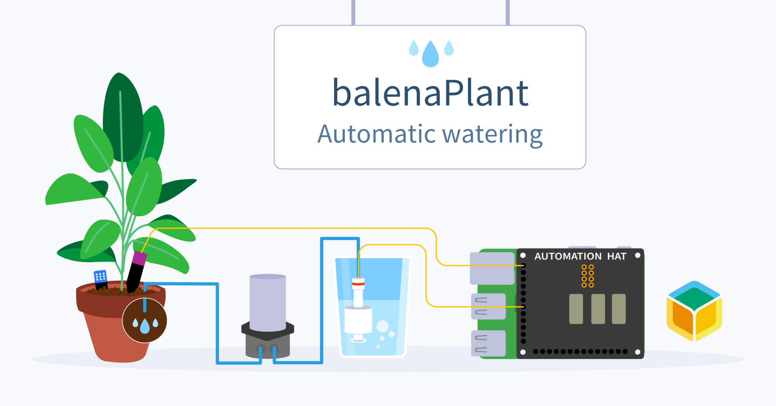
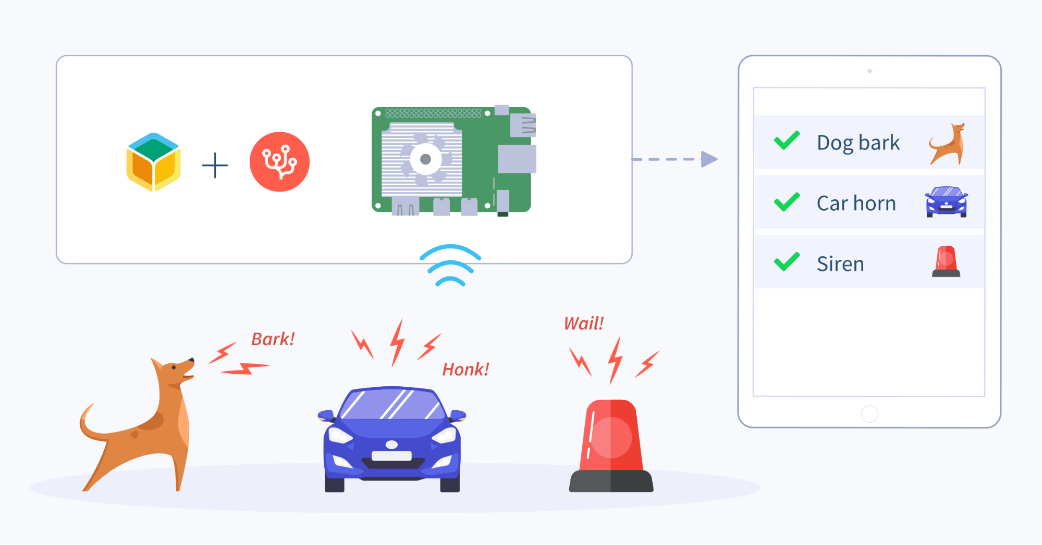
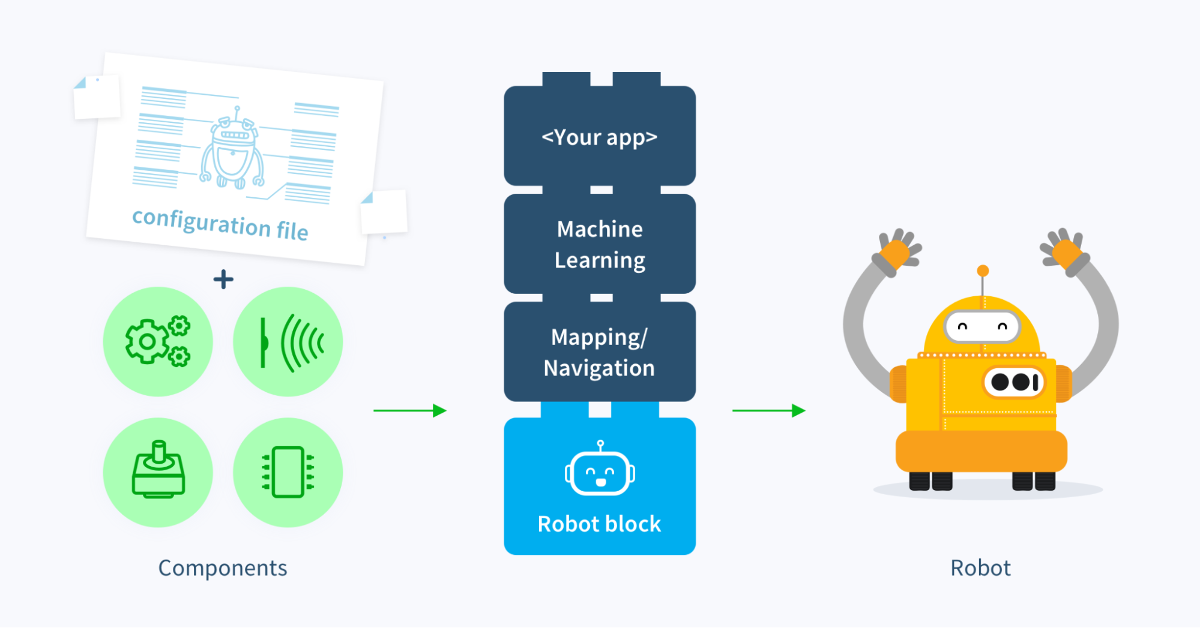
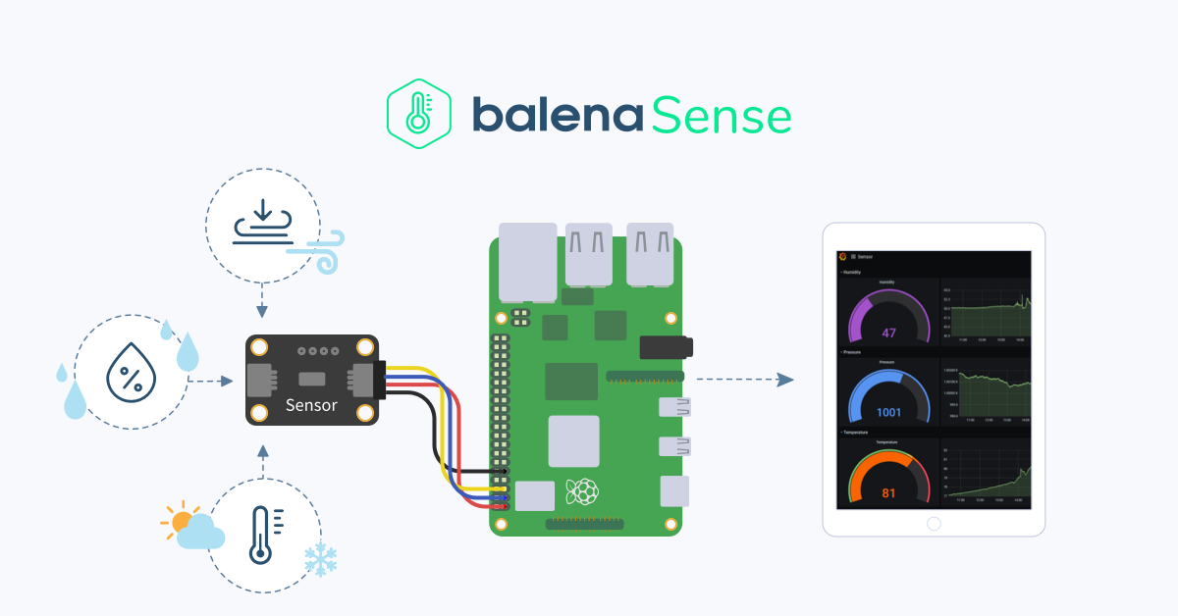
balenaLabs

Slide 32
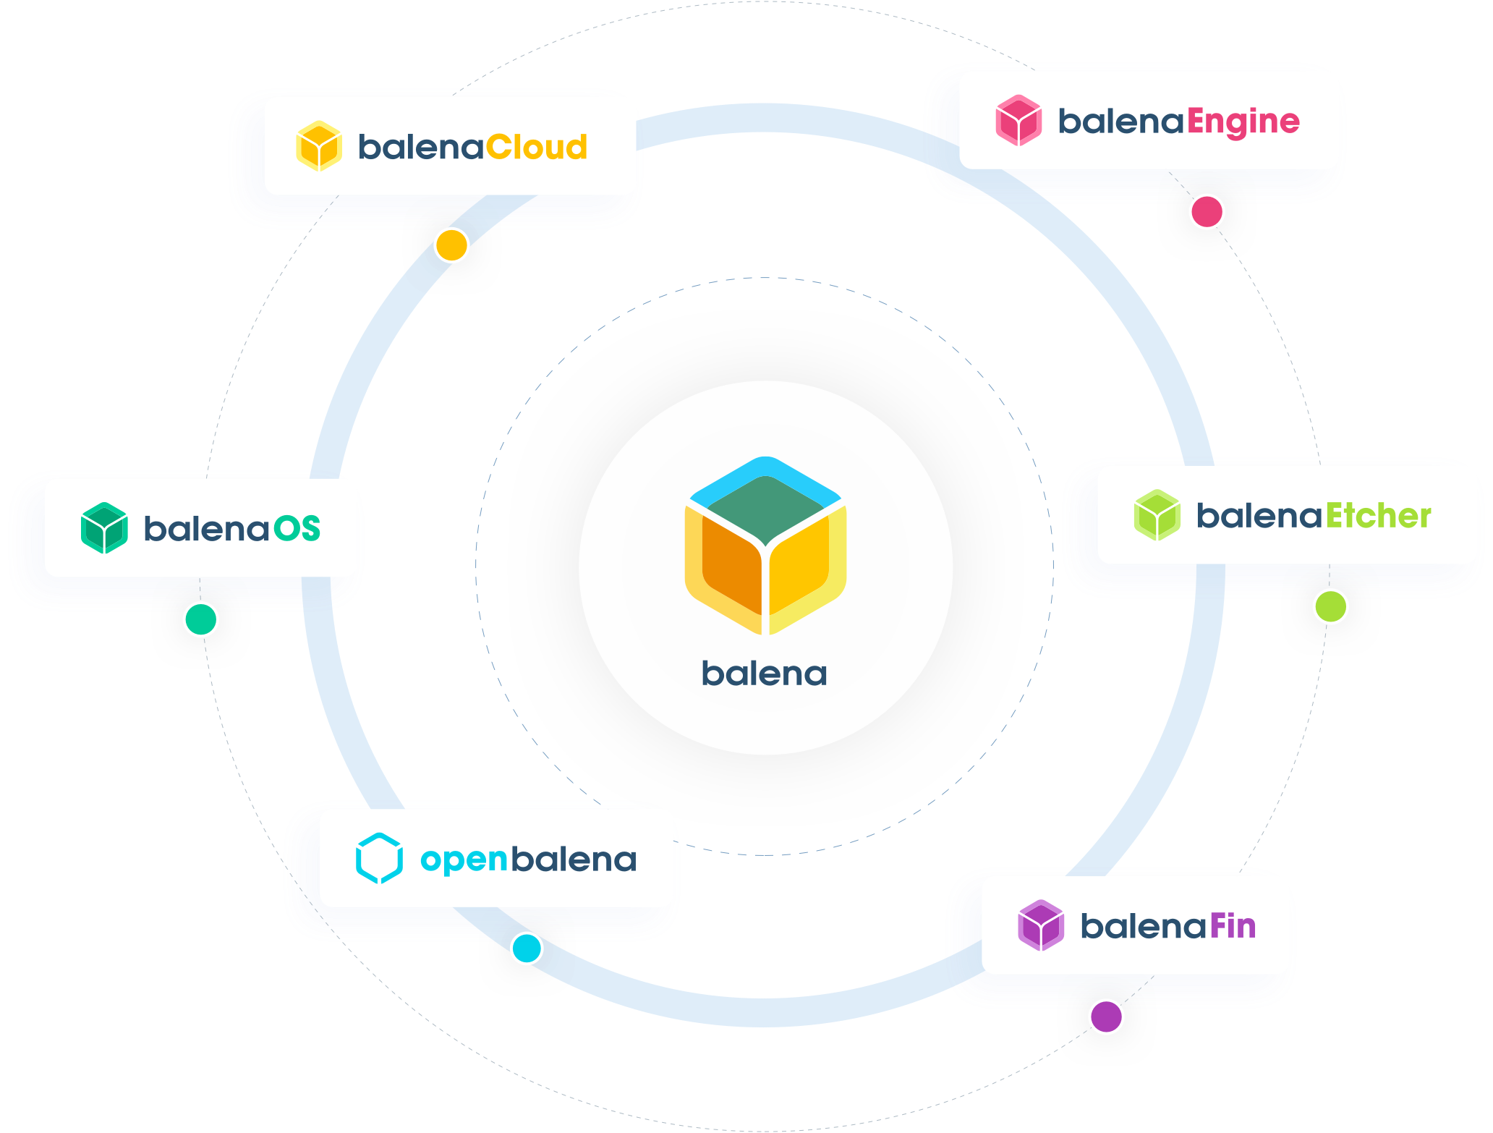

Slide 33
Questions?

Slide 34


